Slide 1

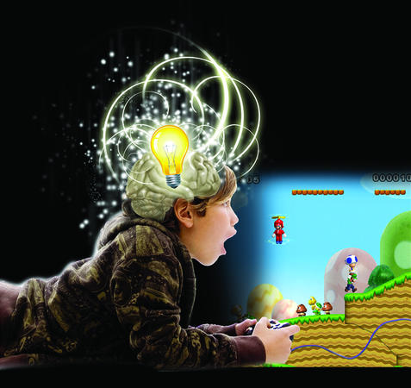
Welcome
Review of latest global psychological research around video game play
How to apply this to development
The future of psychology in video games
Berni Good MBPsS - Cyberpsychologist Limited
Notes:
Member of BPS, area of interests are in well being in video game play for desire to continue to play, ethics, immersion and engagement in video gameplay. I try to fill a void on the academic research valuable and see if that can be applied to the development process.

Slide 2

Ethics
F2P Conference 2013
First a note about ethics
British Psychological Society code of ethics
Important to use research correctly, morally & ethically
Important to protect vulnerable people and in particular
minors
Happy to answer any questions about ethics via email
berni@cyberpsychologist.co.uk
Notes:
Maria Southgate at OFT

Slide 3
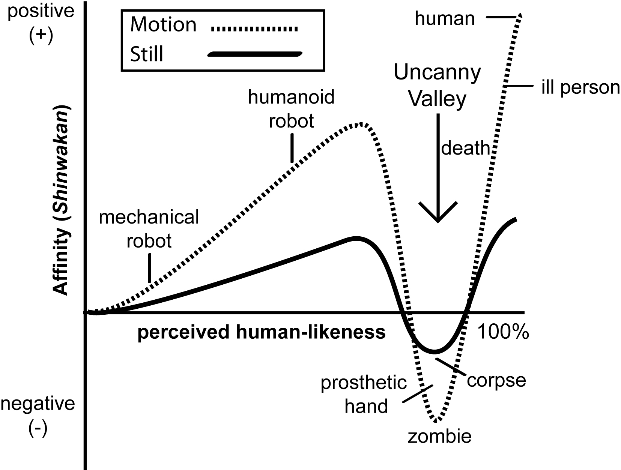
Uncanny Valley – design & development implications
The Uncanny Valley
Jentsch (1906) On the Psychology of the Uncanny
Freud (1919) Psychoanalysis on ‘the Uncanny’.
Marashiro Mori (1970)
Roboticist, theoretical notion of the Uncanny Valley.
Mori’s plot of one’s affinity against human-likeness as the Uncanny Valley taken from a translation by Karl MacDorman and Norri Kageki of Mori’s The Uncanny Valley (2012).

Slide 4
Viewer Perception of Psychopathic Traits in Uncanny Characters
The Uncanny Modality (UM) study
Uncanniness increases with perception of:
A lack of human-likeness in facial expression; the upper face, with the brows and forehead being most significant.
2. A of lack of human-likeness in the character’s voice.
3. An over exaggeration of articulation of the mouth during speech.
4. A of lack of synchronization between the character’s lips and the character’s speech. (Tinwell and Grimshaw 2009; Tinwell, Grimshaw and Williams, 2010, 2011).

Slide 5
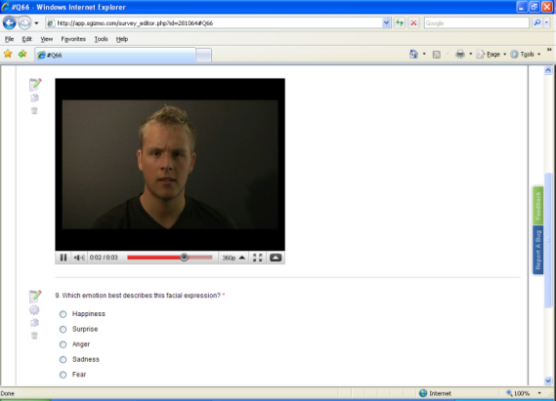
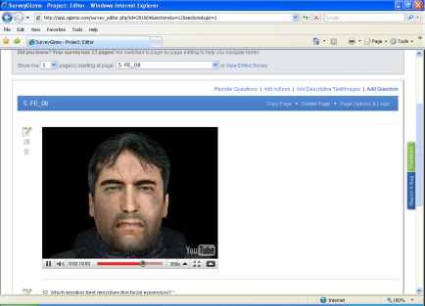
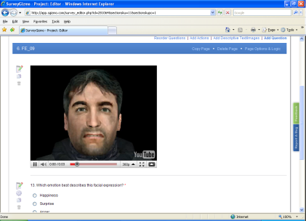
Viewer Perception of Psychopathic Traits in Uncanny Characters
Cross-modal influence: facial expression
129 participants, rated three groups, expressing the six basic emotions for perceived familiarity and human-likeness.
(a) human
b) a fully animated character ‘Full’, and
c) a partially animated character ‘Lack’ with movement disabled above the eyelids

Slide 6
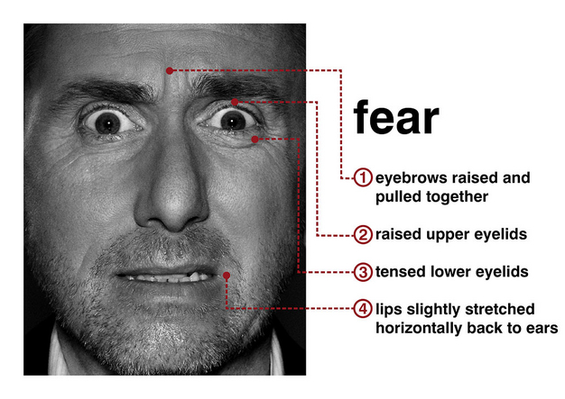
Viewer Perception of Psychopathic Traits in Uncanny Characters
Psychological Cause of the Uncanny Valley
Guidelines have been produced to reduce the uncanny, no research around psychological drivers and what evokes negative response in viewer.
Personality traits such as anger, callousness, coldness, dominance, being unconcerned, and untrustworthiness are associated with psychopathy.
A visual facial marker of psychopathy is a lack of a visible startle response in the eye region to emotive, fearful situations,
Example of a healthy non-psychopathic response to fear

Slide 7
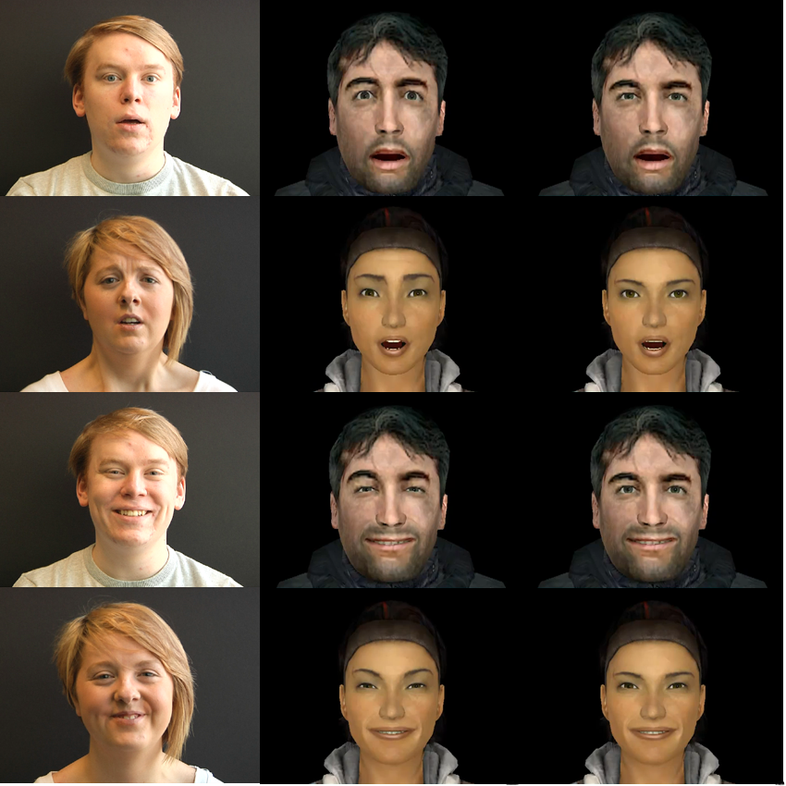
Viewer Perception of Psychopathic Traits in Uncanny Characters
Methodology
205 participants rated 6 videos for:
Six items to measure the uncanny: eerie; nonhuman-like; repulsive; unattractive; unlikeable; and, unresponsive.
Six personality traits associated with psychopathy: angry; cold personality; dominant; uncaring; unconcerned; and, untrustworthy.
Six personality traits not associated with psychopathy: anxiety; shame; depression; hopelessness; nervousness; and, self-consciousness.
Human
Full
Lack
The six videos used in the experiment by academics at Bolton Univerity
All characters portrayed the facial expression of fear in response to a scream sound.

Slide 8
Viewer Perception of Psychopathic Traits in Uncanny Characters
Results of research
The result followed the predicted trend and male human characters and male virtual characters were judged as more uncanny than females
As predicted, virtual characters with a lack of upper facial expression were regarded as more uncanny than virtual characters with full facial movement and humans when all were portraying fear.
This trend also generalizes to female characters too.
(Tinwell, Abdel Nabi and Charlton 2013.)
The Lack Condition

Slide 9
Viewer Perception of Psychopathic Traits in Uncanny Characters
What does this mean for design and player engagement and immersion?
Provide a new psychological explanation of the uncanny; aberrant facial expression in a character may trigger a perception that it has psychopathic traits.
Traits such as anger, coldness, dominance, callousness, being unconcerned, or untrustworthiness were always the best predictor of uncanniness.
Male virtual characters with a lack of upper facial expression were rated as most uncanny and psychopathy ratings were a strong predictor of this uncanniness.
The viewer may be repulsed or shocked by uncanny characters perceiving they are interacting with someone or something with psychopathic traits

Slide 10
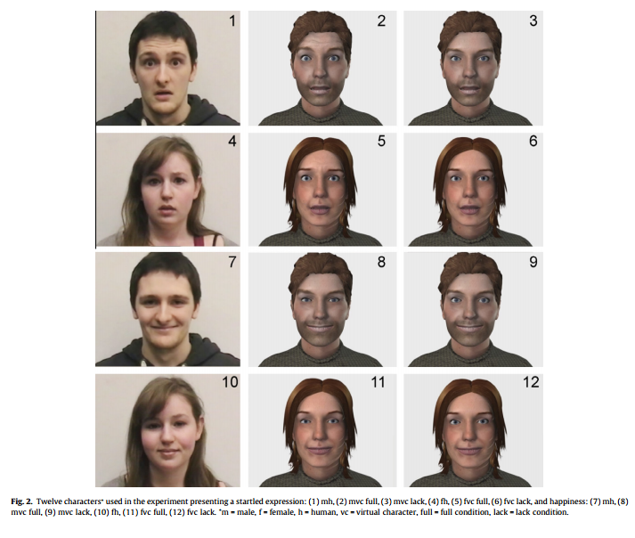
Viewer Perception of Psychopathic Traits in Uncanny Characters
Further research by Tinwell & Sloan (2014) suggests that this can be the same for children aged between 9 – 11.
These children rated the characters with lack of facial movements as the strangest, followed by the animated characters with facial movements, they did not rate human faces as ‘strange’
Gender difference too, males less accepting than females this is consistent with previous research by Tung (2012)
Major implications for design of characters especially for children who are more vulnerable than adults
Notes:
The findings have significant implications for the creation of female virtual characters – is it perceived that these characters have underlying non-nurturing personality traits when they should have nurturing traits?

Slide 11




Uncanny Valley
Realistic, Human-Like Characters
Engagement can be invoked for the player by increasing the sophistication of appearance, motion and sound for human-like characters.
More relatedness to avatars – Avoids disengagement
Notes:
Mary Smith featured in The Casting, a tech demo for the video game Heavy Rain, released at the third Electronic Entertainment Expo in 2006 by the developers Quantic Dream which was heavily criticised
Review of latest global psychological research around video game play

Slide 12




Viewer Perception of Psychopathic Traits in Uncanny Characters
Experience of the uncanny may serve a useful real world survival function to avoid a potential threat or harm to oneself. Fight or flight....
Uncanny being evoked by lack of emotional response in upper facial area could be linked Evolutionary Psychological instinct?
Not good for plastic surgery industry – now we know why we are so repulsed by Botox or other procedures that evoke the uncanny.

Slide 13



Viewer Perception of Psychopathic Traits in Uncanny Characters
The findings have significant implications for the creation of female virtual characters – is it perceived that these characters have underlying non-nurturing personality traits when they should have nurturing traits?
Female psychopaths can demonstrate a lack of empathetic concern similar to (or more than) their male counter-parts.
Examples of female murderers who show psychopathic visual markers.
This tactic may be used strategically in games design for criminals featured in crime-thriller and/or horror video games.
Findings relevant for clinical applications in e-learning for example, or AI caring for elderly for example.
Hits right at the heart of one of the three components of Self Determination Theory ‘relatedness’ – critical for engagement!

Slide 14


The allure of horror game
The psychology of horror - why is horror so compelling?
Horror genre is incredibly successful but why?
Fear – timeless cross-cultural desire to avoid this unpleasant emotions – but only some of the time
Our ancestors feared they would be eaten by carnivorous animals
In our nature to be afraid – evolutionary psychology

Slide 15



Why so damn scary?
Why are we scared?
Ancestors had an awareness that they were meat, eaten by large felines etc.,
3 years olds can spot snakes on screen more than flowers etc.,
The amygdala (region of brain associated with fear) responds more to animals than landmarks
Not the same as cars and guns, its way more deeply ingrained in us, its ‘innate’

Slide 16

Why so damn scary?
What other things are we scared of & why?
Mystical fiends and ware wolves zombies and ghosts
Are these souped up versions of our ancestors threats,
strong, unstoppable & hungry?
Sometimes fit the human category in most respects
accept they are undead
These exploit topics and images that we fear
Zombies are really horrible they exploit our fear of infection
We have a deep seated reaction of disgust to being infected
These can evoke the uncanny valley with their jerky nearly but not quite human behaviour and look
We enjoy killing them in games because we have no moral question about removing them – we can be hero or warrior and we get great relaxation from this.
Theory of mind – if we perceive they have agency but cannot read their facial expressions this is why clowns are so scary – they hide behind their masks!

Slide 17



What's happening in the mind?
Your brain on horror
Also looked at sensation seeking. Consistent with prior research that found sensation seekers are more aroused by stimulating material, high scorers on sensation seeking in the present study showed a greater response in the visual cortex when watching horror clips.
Also, high sensation seekers exhibited lower activity in the thalamus and insula during neutral clips, consistent with the idea that they might be under-aroused in usual circumstances

Slide 18

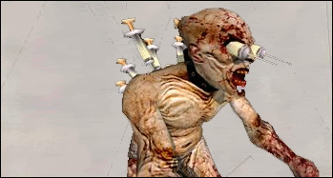
Good horror games that tap into psychology
A selection of games that do scary very well!
Manhunt – Pigsy... retarded, chainsaw-wielding psycho in a pig’s head who was kept chained up in an attic – go figure...
The Suffering – Mainliner.....represented death by lethal injection, which meant he was covered with needles, worse than a heroin junkie – he even had them hanging from his eyes. And lunged at you too....WTF?

Slide 19


Good horror games that tap into psychology
Dead rising – Adam the clown....ugly, face-painted creature with goofy red hair and a crazy, psychotic laugh yielding a chainsaw. Who knew the name Adam was so scary?
Dead Space – Necromorphs... basically corpses that had been reshaped by an extraterrestrial infection and their only purpose is to spread that infection....Nice!

Slide 20


Good horror games that tap into psychology
Resident Evil 3 - Nemesis – his weapon of choice was a rocket-launcher, even though he had the ability to poison you with his venomous tentacles...definitely not a looker!
Silent Hill – Pyramid Head.....The most horrendous psychopathic warped creature, while his Great Knife and spears represents phallic imagery – which wraps us right back around to Pyramid Head engaging in acts of rape with monsters throughout the game....Nut-job – lock your daughters up!

Slide 21
Psychological Research on Character Attachment
F2P Conference 2013
What is Character Attachment?
The viewers disposition towards the character they are observing influences enjoyment. (Bowman, Schultheiss & Schumann, 2013)
Research on identification suggests that audiences regularly imagine being the character, and research around parasocial experiences suggest that people react to character as if they were real, physical beings.
In virtual worlds people literally suspend their sense of self and how the character is treated by the game and other players and NPC’s will evoke VERY REAL emotions in the player
In video games psychologists argue that the player will be inserted into the
game environment via the media character – that is to say become present in the game via the character
In media CA there is a meeting of the minds (Oakley, 1999) in video gaming this can be seen as internalising and psychological merging of players and characters mind!
Good character design will allow for the gamer to immerse themselves in the emotional and physical world of the character
Notes:
In their study on character attachment, Lewis, Weber, and Bowman (2008) found that character attachment is conceptualized as a combination of a player’s liking/identification with the character, suspension of disbelief of the game (i.e., acceptance of the world compared to picking out flaws and inconsistencies), perceived control over the character, and their responsibility and care towards the character’s perceived wellbeing and needs.

Slide 22

Psychological Research on Character Development
F2P Conference 2013
Measuring Player Avatar Identification (PAI) Li, Liau, & Khoo (2013)
Developed a 4 factor model which included: feelings during play, absorption during play, positive attitudes toward the game avatar and importance of the avatar to one’s self identity.
The term ‘‘identification’’ was first used by Freud and later other psychoanalysts to explain the process of personality formation through taking the role of the other (Freud, 1938, 1962)
Notes:
Similarly Livingstone (1998) described identification with TV characters as imagining being in someone else’s shoes and seeing the world through his or her eyes
WCohen (2001) looked at media character identification, suggesting a process that involves perception toward the character, adopts goals of the character, and consists of ‘‘increasing loss of self-awareness and its temporary replacement with heightened emotional and cognitive connections with a character”
ork of South Korean psychology researchers in F2P consumer psychology model, very ambitious and interesting and also take a quick look at jealousy and envy theory in psychology from the conspicuous consumption perspective and lastly look at a model that has been used extensively to understand how developers can address intrinsic needs of gamer.

Slide 23
When my character is facing
The characters I play reflect who I am
My character and I are one and the same
The characters I play influence the way I f
Psychological Research on Character Development
F2P Conference 2013
When my character is facing danger in the game, I feel nervous
I feel the same disappointment when my character experiences a failure in the game
When my character achieves his/her goals, I feel happy
I feel the same joy my character experiences when a task is accomplished
I have forgotten my surroundings during the game
I have forgotten myself during the game
I feel as if I am physically in the game world during the game
I never regret that I play my game character
I am proud to play the character I am playing now
Other gamers are happy to be friends with my game character
My co-gamers have high respect for my character
The characters I play reflect who I am
My character and I are one and the same
The characters I play influence the way I feel about myself
The characters I play are important to my sense of what kind of a person I am
Notes:
Work of South Korean psychology researchers in F2P consumer psychology model, very ambitious and interesting and also take a quick look at jealousy and envy theory in psychology from the conspicuous consumption perspective and lastly look at a model that has been used extensively to understand how developers can address intrinsic needs of gamer.

Slide 24
Psychological Research around Character Development/Attachment
F2P Conference 2013
PAI in this study is defined as the status when a player is absorbed in video games with heightened feelings and adopts certain aspects of the in-game identity both emotionally and cognitively
A total of 1263 students from Singapore primary and secondary schools participated in this study, out of which 935 self-identified gamers completed PAIS
The inclusion of feelings and absorption to define identification has surfaced repeatedly in the literature (Bandura & Huston, 1961; Cohen, 2001; Hoffner & Buchanan, 2005; Kagan, 1958). Similarly, these two constructs also formed important parts in defining PAI.
Recent brain research has shown that the intense emotional involvement with avatar resembles the level of intimacy one experiences when interacting with a close other (Ganesh et al., 2011).
An early study on identification with film characters, Maccoby and Wilson (1957) defined the process as ‘‘the viewer, in fantasy, puts himself in the place of a character and momentarily feels that what is happening to that character is happening to himself

Slide 25
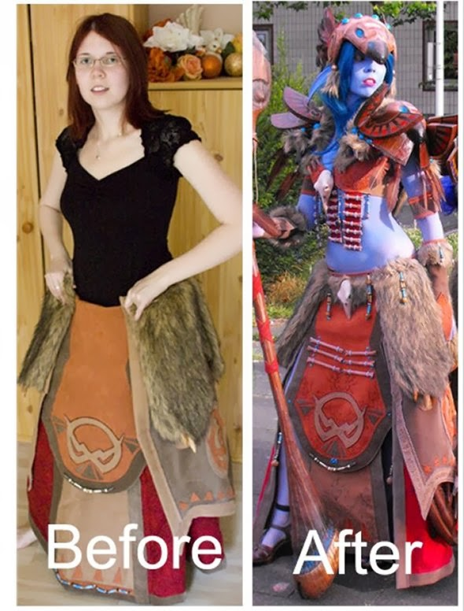
Psychological Research on Character Development
F2P Conference 2013
When my character is facing danger in the game, I feel nervous
The characters I play influence the way I feel about myself
The characters I play are important to my sense of what kind of a person I am
haracters I play influence the way I feel about myself
The characters I play are important to my sense of what kind of a person I am
Coulson, Barnett, Ferguson, and Gould (2012) found that virtual characters may be liked and even loved by the real people with whom they interact. These findings partly addresses the debate about whether player could have empathic feelings toward one’s own avatar. It thus provides support to the inclusion of feelings and absorption to define PAI in this
In this model, players are motivated to escape into games because of a narrowed gap between one’s actual self and ideal self during play. The model provided some empirical support for identification and enjoyment theory (Klimmt et al., 2009, 2010). This theory posits that identification is enjoyable for game players due to the reason that altered self-perceptions during game exposure reduce self-discrepancies.
Notes:
Work of South Korean psychology researchers in F2P consumer psychology model, very ambitious and interesting and also take a quick look at jealousy and envy theory in psychology from the conspicuous consumption perspective and lastly look at a model that has been used extensively to understand how developers can address intrinsic needs of gamer.

Slide 26

Psychological Research on Character Development
F2P Conference 2013
When my character is facing danger in the game, I feel nervous
The characters I play influence the way I feel about myself
The characters I play are important to my sense of what kind of a person I am
haracters I play influence the way I feel about myself
The characters I play are important to my sense of what kind of a person I am
We can become attached to NPC’s too and some recent work I have been looking at involves developing NPC’s or AI in games to be able to ‘relate’ to older people helping to overcome isolation and loneliness.
Samantha: Is that weird? You think I'm weird?
Theodore: Kind of.
Samantha: Why?
Theodore: Well, you seem like a person but you're just a voice in a computer.
Samantha: I can understand how the limited perspective of an unartificial mind might perceive it that way. You'll get used to it.
[Theodore laughs]
Samantha: Was that funny?
Theodore: Yeah.
Samantha: Oh good, I'm funny!
Notes:
Work of South Korean psychology researchers in F2P consumer psychology model, very ambitious and interesting and also take a quick look at jealousy and envy theory in psychology from the conspicuous consumption perspective and lastly look at a model that has been used extensively to understand how developers can address intrinsic needs of gamer.

Slide 27
Back to basics
F2P Conference 2013
Social Psychology – the basics
We are social beings interaction is very important
People thoughts, feelings, actions and behaviours as influenced by real, imagined or even implied presence of ‘others’
Fundamental for good psychological health – cannot be underestimated.
We are prone to social influence even when no other people are present, such as when watching television, playing video games or following internalized cultured norms
What are the factors that lead us to behave in a given way in the presence of others.
Under what conditions do certain behavior/actions and feelings occur?
Social psychology is concerned with the way these feelings, thoughts, beliefs, intentions and goals are constructed and how such psychological factors, in turn, influence our interactions with others.
Notes:
Maria Southgate at OFT

Slide 28
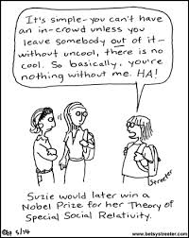
Back to basics
F2P Conference 2013
Some key theories of Social Psychology
Influence of others Social Identity Theory (SIT) and Self Determination Theory (SDT)
SIT first - Groups are important not only because they offer social support, resources, and a feeling of belonging, but because they supplement an individual's self-concept
SIT to do with our identity, self concept in relation to perceived membership of a particular group
Its about ‘intergroup’ – perceived status of an in group
Social Identity Theory (SIT, Tajfel & Turner, 1986) stipulates that people shape their identity according to their social group. Moreover, the ties between identity and social groupings are associated with motivation. Engaging in activities that are characteristic of the group .
Notes:
Maria Southgate at OFT

Slide 29

Silver Gamers how to create games for this market
Guardian (2015)
16 trends that will define the future of video games
Berni Good MBPsS - Cyberpsychologist Limited

Slide 30
13. Rise of the silver gamers
As the population ages, we’re going to see an increasing number of people either carrying on gaming into retirement, or perhaps discovering gaming in their later years. That’s a huge market for developers to explore.
Helping people to cope with isolation could be one huge benefit. “We are social beings and social interaction is very important,” says cyber-psychologist Berni Good who presented a talk about silver gamers at Develop. “We know that people’s thoughts, feelings, actions and behaviours are influenced by real, imagined or even the implied presence of ‘others’ and, even if that’s with non-player characters in video games.
“As psychologists we are beginning to understand that eudaemonics (the theory of being happy) can be realised with engagement and immersion on video game play. Research on character identification suggests that audiences regularly imagine being the character, and research around parasocial experiences suggest that people react to character as if they were real, physical beings.”

Slide 31
So there may soon be a large market for games that simulate social experiences in a very different way than current titles – or that emphasise or exploit the greater range of life experiences of older players. Good argues that ageing gamers may find they have important roles to play in shared co-op experiences with younger relatives. “With added moral and ethical choices in games, older people may have more emotional intelligence than younger players,” says Good. “Older players may not be able to pursue the hobbies they used to because they just don’t have the same stamina or capability. This is where video games can really help, by playing games, older people can still get a sense of purpose, they can relate to others in a meaningful way.”

Slide 32


The connected world getting lonelier
F2P Conference 2013
Isolation and loneliness
We are living longer than ever before – 1 in 10 (11%) older people have no close friends
Loneliness is in terms of health is the equivalent of smoking 15 cigarettes a day
We are more connected than ever but 4 in 10 people have less social interactions with people they know.
Social capital is the key here – if you cannot get face to face humans interactions what else is available?
The brain treats loneliness the same way as physical pain it is incredibly stressful and debilitating
But also younger people too are spending less time face to face – age 45 – 54 only meet socially once per week.

Slide 33

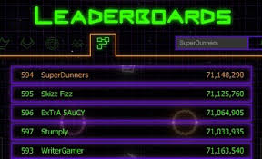
Back to basics
F2P Conference 2013
Social Psychology – Fundamental for wellbeing and to counter loneliness and isolation. Gamers my age will seek comfort and social interactions well in to old age
.
Notes:
Maria Southgate at OFT

Slide 34
What Psychologists now know
F2P Conference 2013
What does the research say?
Allaire et al (2013) studied the Socioemotional differences between older adult gamers and Non-gamers
The investigation was to examine differences in psychological functioning (e.g., well- being, affect, depression, and social functioning) between older adults who play digital games compared to those older adults that do not play digital games.
Of 140 independently living older adults with an average age of 77.47 years
Well-being, negative affect, social functioning and depression with Regular and Occasional Gamers performing better, on average, than Non-gaming older adults
Authors observe the sales figures of Nintendo ’s Brain Age, suggest that a dislike of gaming related to age is perhaps just a stereotype
The disinhibition effect means that people are more socially lubricated when they communicate via virtual worlds.

Slide 35
The connected world getting lonelier
F2P Conference 2013
Belchior et al (2013) investigated the effect of video game training on older adult’s useful field of view performance
Fifty-eight older adult participants were randomized to receive practice with the target action game (Medal of Honor ), a placebo control arcade game (Tetris), a clinically validated (user field of view) UFOV training program or no contact control.
All three intervention groups improved significantly more than no-contact controls. There was a lack of difference between the two game conditions
Chua et al (2013) looked at intergenerational gaming – older people playing with younger people.
Longitudinal study that investigates the effects of video-game play on intergenerational perceptions amongst youths and the elderly after participating in a program involving regular interaction sessions over two months
In addition, the results showed that game enjoyment played an important role in developing positive intergenerational perceptions only for the elderly

Slide 36

Gamers playing violent game
Competence the second psychological need discussed within SDT looks at opportunities for individuals to acquire new skills or be challenged and receive positive feedback and this fulfils intrinsic motivation. Within video game play an example of competence would be where the game can be mastered and challenges within the game can be optimised and there are opportunities for positive feedback. (Rigby & Ryan 2007; Rigby & Ryan, 2011). Competence can be defined as feeling a sense of effectedness (Rigby & Ryan, 2011), with people intrinsically motivated to pursue opportunities to feel competent, because feeling effective gives us energy and motivates further. Mastering the mechanics of game play and accomplishing achievements via levels or tasks in game play enables this sense of competence which in turn adds to the feeling of well being.
Competence the second psychological need discussed within SDT looks at opportunities for individuals to acquire new skills or be challenged and receive positive feedback and this fulfils intrinsic motivation. Within video game play an example of competence would be where the game can be mastered and challenges within the game can be optimised and there are opportunities for positive feedback. (Rigby & Ryan 2007; Rigby & Ryan, 2011). Competence can be defined as feeling a sense of effectedness (Rigby & Ryan, 2011), with people intrinsically motivated to pursue opportunities to feel competent, because feeling effective gives us energy and motivates further. Mastering the mechanics of game play and accomplishing achievements via levels or tasks in game play enables this sense of competence which in turn adds to the feeling of well being.
Mastering the mechanics of game play and accomplishing achievements via levels or tasks in game play enables this sense of competence which in turn adds to the feeling of well being.
Mastering the mechanics of game play and accomplishing achievements via levels or tasks in game play enables this sense of competence which in turn adds to the feeling of well being.
Mastering the mechanics of game play and accomplishing achievements via levels or tasks in game play enables this sense of competence which in turn adds to the feeling of well being.
Mastering the mechanics of game play and accomplishing achievements via levels or tasks in game play enables this sense of competence which in turn adds to the feeling of well being.
What they say:
People everybody come on I can't stand them anymore
The graphics are fantastic
Shut up
I got a knife, with a knife your closer to the victim (laughs)
Who the man!
Here comes the guy, kill the guy!
Oh baby an AR15 (gun)
I am looking for trouble!
Come on kill some cops
Shoot him again, he's not dead yet! Get her too!
I got a gun, where's the person!
I shot some people (laughs)
You'll never take me alive

Slide 37

A word to the wise
Mastering the mechanics of game play and accomplishing achievements via levels or tasks in game play enables this sense of competence which in turn adds to the feeling of well being.
Mastering the mechanics of game play and accomplishing achievements via levels or tasks in game play enables this sense of competence which in turn adds to the feeling of well being.
Mastering the mechanics of game play and accomplishing achievements via levels or tasks in game play enables this sense of competence which in turn adds to the feeling of well being.
Mastering the mechanics of game play and accomplishing achievements via levels or tasks in game play enables this sense of competence which in turn adds to the feeling of well being.
Competence the second psychological need discussed within SDT l. Within video game play an example of competence would be where the game can be mastered and challenges within the game can be optimised and there are opportunities for positive feedback. (Rigby & Ryan 2007; Rigby & Ryan, 2011). Competence can be defined as feeling a sense of effectedness (Rigby & Ryan, 2011), with people intrinsically motivated to pursue opportunities to feel competent, because feeling effective gives us energy and motivates further. Mastering the mechanics of game play and accomplishing achievements via levels or tasks in game play enables this sense of competence which in turn adds to the feeling of well being.
Competence the second psychological need discussed within SDT looks at opportunities for individuals to acquire new skills or be challen
Older people however have more of a moral compass
This is make believe
That's expressive language!
Its a weird satisfaction
They are gonna cancel my insurance for Godsake!
I’m waiting for the light to change and there's a pedestrian too
Why did you stop? Cause its a stop sign.....
This doesn't encourage crime, if anybody does that they are predetermined to do that anyway
There's too much happening for me at one time
This is make believe
I had fun with the violence because its just a game
Its very FUN to do naughty things

Slide 38


Animated Virtual Assistants
Realistic, Human-Like Characters or cartoons
More relatedness to avatars –
Notes:
Mary Smith featured in The Casting, a tech demo for the video game Heavy Rain, released at the third Electronic Entertainment Expo in 2006 by the developers Quantic Dream which was heavily criticised
Review of latest global psychological research around video game play

Slide 39
Really important practical psychological stuff to build into your games!
Self Determination Theory (SDT)
Well researched theory over 30 years old around motivation
To do with eudaemonics (the theory of being happy!) and researched around engagement and immersion on video game play
Addresses intrinsic needs versus wants
Three key components to SDT:
Autonomy
Well Being
Self Determination Theory
(intrinsic needs)
Relatedness
Happiness
Competence

Slide 40
Self Determination Theory
Competence the second psychological need discussed within SDT looks at opportunities for individuals to acquire new skills or be challenged and receive positive feedback and this fulfils intrinsic motivation. Within video game play an example of competence would be where the game can be mastered and challenges within the game can be optimised and there are opportunities for positive feedback. (Rigby & Ryan 2007; Rigby & Ryan, 2011). Competence can be defined as feeling a sense of effectedness (Rigby & Ryan, 2011), with people intrinsically motivated to pursue opportunities to feel competent, because feeling effective gives us energy and motivates further. Mastering the mechanics of game play and accomplishing achievements via levels or tasks in game play enables this sense of competence which in turn adds to the feeling of well being.
Competence the second psychological need discussed within SDT looks at opportunities for individuals to acquire new skills or be challenged and receive positive feedback and this fulfils intrinsic motivation. Within video game play an example of competence would be where the game can be mastered and challenges within the game can be optimised and there are opportunities for positive feedback. (Rigby & Ryan 2007; Rigby & Ryan, 2011). Competence can be defined as feeling a sense of effectedness (Rigby & Ryan, 2011), with people intrinsically motivated to pursue opportunities to feel competent, because feeling effective gives us energy and motivates further. Mastering the mechanics of game play and accomplishing achievements via levels or tasks in game play enables this sense of competence which in turn adds to the feeling of well being.
Mastering the mechanics of game play and accomplishing achievements via levels or tasks in game play enables this sense of competence which in turn adds to the feeling of well being.
Mastering the mechanics of game play and accomplishing achievements via levels or tasks in game play enables this sense of competence which in turn adds to the feeling of well being.
Mastering the mechanics of game play and accomplishing achievements via levels or tasks in game play enables this sense of competence which in turn adds to the feeling of well being.
Mastering the mechanics of game play and accomplishing achievements via levels or tasks in game play enables this sense of competence which in turn adds to the feeling of well being.
Relatedness – Everybody needs somebody sometime.... - Dean Martin
Relatedness within SDT offer the opportunity to relate to others in a meaningful way. We are social beings this is a very strong psychological need.
Social multiplay, social networking, playing with pals and even relating to games characters can enhance this intrinsic need, and can contribute to a player motivation and enjoyment.
Feedback from NPC is important as well as leaderboards, comments on facebook, NPC’s giving the player the opportunity to feel relevant.. Recognising and acknowledging the accomplishments of the player will all add to this sense of relatedness.
Some interesting aspects of Social Identity Theory (in-group – out-group, people identify with some groups and separate form others) are important here (Tajfel, 1970). Groupthink the desire for social harmony and cohesiveness (Janis, 1971) (may result in wrong decisions being made)
Notes:
Master of own destiny – real world perception of high autonomy but not really.....

Slide 41
Self Determination Theory
Competence the second psychological need discussed within SDT looks at opportunities for individuals to acquire new skills or be challenged and receive positive feedback and this fulfils intrinsic motivation. Within video game play an example of competence would be where the game can be mastered and challenges within the game can be optimised and there are opportunities for positive feedback. (Rigby & Ryan 2007; Rigby & Ryan, 2011). Competence can be defined as feeling a sense of effectedness (Rigby & Ryan, 2011), with people intrinsically motivated to pursue opportunities to feel competent, because feeling effective gives us energy and motivates further. Mastering the mechanics of game play and accomplishing achievements via levels or tasks in game play enables this sense of competence which in turn adds to the feeling of well being.
Competence the second psychological need discussed within SDT looks at opportunities for individuals to acquire new skills or be challenged and receive positive feedback and this fulfils intrinsic motivation. Within video game play an example of competence would be where the game can be mastered and challenges within the game can be optimised and there are opportunities for positive feedback. (Rigby & Ryan 2007; Rigby & Ryan, 2011). Competence can be defined as feeling a sense of effectedness (Rigby & Ryan, 2011), with people intrinsically motivated to pursue opportunities to feel competent, because feeling effective gives us energy and motivates further. Mastering the mechanics of game play and accomplishing achievements via levels or tasks in game play enables this sense of competence which in turn adds to the feeling of well being.
Mastering the mechanics of game play and accomplishing achievements via levels or tasks in game play enables this sense of competence which in turn adds to the feeling of well being.
Mastering the mechanics of game play and accomplishing achievements via levels or tasks in game play enables this sense of competence which in turn adds to the feeling of well being.
Mastering the mechanics of game play and accomplishing achievements via levels or tasks in game play enables this sense of competence which in turn adds to the feeling of well being.
Mastering the mechanics of game play and accomplishing achievements via levels or tasks in game play enables this sense of competence which in turn adds to the feeling of well being.
Competence – You can't fake creativity, competence or sexual arousal....Douglas Coupland
Competence within SDT looks at opportunities for individuals to acquire new skills or be challenged and receive positive contextual feedback and this fulfils intrinsic motivation.
Competence can be defined as feeling a sense of effectedness (Rigby & Ryan, 2011), with people intrinsically motivated to pursue opportunities to feel competent, because feeling effective gives us energy and motivates further.
Within video game play an example of competence would be where the game can be mastered and challenges within the game can be optimised and there are opportunities for positive feedback.
Mastering the mechanics of game play and accomplishing achievements via levels or tasks in game play enables this sense of competence which in turn adds to the feeling of well-being.
Notes:
Included some very high profile resources such as Live Gamer, probably the worlds largest

Slide 42
Self Determination Theory
Competence the second psychological need discussed within SDT looks at opportunities for individuals to acquire new skills or be challenged and receive positive feedback and this fulfils intrinsic motivation. Within video game play an example of competence would be where the game can be mastered and challenges within the game can be optimised and there are opportunities for positive feedback. (Rigby & Ryan 2007; Rigby & Ryan, 2011). Competence can be defined as feeling a sense of effectedness (Rigby & Ryan, 2011), with people intrinsically motivated to pursue opportunities to feel competent, because feeling effective gives us energy and motivates further. Mastering the mechanics of game play and accomplishing achievements via levels or tasks in game play enables this sense of competence which in turn adds to the feeling of well being.
Competence the second psychological need discussed within SDT looks at opportunities for individuals to acquire new skills or be challenged and receive positive feedback and this fulfils intrinsic motivation. Within video game play an example of competence would be where the game can be mastered and challenges within the game can be optimised and there are opportunities for positive feedback. (Rigby & Ryan 2007; Rigby & Ryan, 2011). Competence can be defined as feeling a sense of effectedness (Rigby & Ryan, 2011), with people intrinsically motivated to pursue opportunities to feel competent, because feeling effective gives us energy and motivates further. Mastering the mechanics of game play and accomplishing achievements via levels or tasks in game play enables this sense of competence which in turn adds to the feeling of well being.
Mastering the mechanics of game play and accomplishing achievements via levels or tasks in game play enables this sense of competence which in turn adds to the feeling of well being.
Mastering the mechanics of game play and accomplishing achievements via levels or tasks in game play enables this sense of competence which in turn adds to the feeling of well being.
Mastering the mechanics of game play and accomplishing achievements via levels or tasks in game play enables this sense of competence which in turn adds to the feeling of well being.
Mastering the mechanics of game play and accomplishing achievements via levels or tasks in game play enables this sense of competence which in turn adds to the feeling of well being.
Autonomy – I am the master of my own destiny.....Anon
Autonomy within SDT offer meaningful choices and volitional action which in turn enhance well being and intrinsic motivations.
Playing video games is usually voluntary Rigby & Ryan. (2011) suggesting that when playing video games a person's autonomy will already be high, and depending on the game decisions within the game play that allow choice of direction autonomy can be enhanced.
Within video game play an example of autonomy would be different paths to take, different paths to choose from and directions in game play to take, what to buy in the game, how much to spend, what weapons etc.,
When people experience autonomy they are happier, healthier and more motivated (Rigby & Ryan, 2011) people will stay and seek out pursuits that give them a sense of autonomy.
Notes:
Master of own destiny – real world perception of high autonomy but not really.....

Slide 43
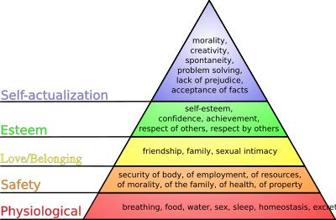
Maslows Hierarchy of needs
Competence the second psychological need discussed within SDT looks at opportunities for individuals to acquire new skills or be challenged and receive positive feedback and this fulfils intrinsic motivation. Within video game play an example of competence would be where the game can be mastered and challenges within the game can be optimised and there are opportunities for positive feedback. (Rigby & Ryan 2007; Rigby & Ryan, 2011). Competence can be defined as feeling a sense of effectedness (Rigby & Ryan, 2011), with people intrinsically motivated to pursue opportunities to feel competent, because feeling effective gives us energy and motivates further. Mastering the mechanics of game play and accomplishing achievements via levels or tasks in game play enables this sense of competence which in turn adds to the feeling of well being.
Competence the second psychological need discussed within SDT looks at opportunities for individuals to acquire new skills or be challenged and receive positive feedback and this fulfils intrinsic motivation. Within video game play an example of competence would be where the game can be mastered and challenges within the game can be optimised and there are opportunities for positive feedback. (Rigby & Ryan 2007; Rigby & Ryan, 2011). Competence can be defined as feeling a sense of effectedness (Rigby & Ryan, 2011), with people intrinsically motivated to pursue opportunities to feel competent, because feeling effective gives us energy and motivates further. Mastering the mechanics of game play and accomplishing achievements via levels or tasks in game play enables this sense of competence which in turn adds to the feeling of well being.
Mastering the mechanics of game play and accomplishing achievements via levels or tasks in game play enables this sense of competence which in turn adds to the feeling of well being.
Mastering the mechanics of game play and accomplishing achievements via levels or tasks in game play enables this sense of competence which in turn adds to the feeling of well being.
Mastering the mechanics of game play and accomplishing achievements via levels or tasks in game play enables this sense of competence which in turn adds to the feeling of well being.
Mastering the mechanics of game play and accomplishing achievements via levels or tasks in game play enables this sense of competence which in turn adds to the feeling of well being.
Maslow was an American Psychologist
theory of psychological health predicated on fulfilling innate human needs in priority, culminating in self-actualization.
In video games strive to achieve the top of this pyramid, self actualisation through achievements and progress in games.
Driving force that draws people to games was not fun — which doesn’t keep players interested — but instead a sense of achievement, freedom and even social connectedness.
Notes:
Master of own destiny – real world perception of high autonomy but not really.....

Slide 44

Profiling.....
Competence the second psychological need discussed within SDT looks at opportunities for individuals to acquire new skills or be challenged and receive positive feedback and this fulfils intrinsic motivation. Within video game play an example of competence would be where the game can be mastered and challenges within the game can be optimised and there are opportunities for positive feedback. (Rigby & Ryan 2007; Rigby & Ryan, 2011). Competence can be defined as feeling a sense of effectedness (Rigby & Ryan, 2011), with people intrinsically motivated to pursue opportunities to feel competent, because feeling effective gives us energy and motivates further. Mastering the mechanics of game play and accomplishing achievements via levels or tasks in game play enables this sense of competence which in turn adds to the feeling of well being.
Competence the second psychological need discussed within SDT looks at opportunities for individuals to acquire new skills or be challenged and receive positive feedback and this fulfils intrinsic motivation. Within video game play an example of competence would be where the game can be mastered and challenges within the game can be optimised and there are opportunities for positive feedback. (Rigby & Ryan 2007; Rigby & Ryan, 2011). Competence can be defined as feeling a sense of effectedness (Rigby & Ryan, 2011), with people intrinsically motivated to pursue opportunities to feel competent, because feeling effective gives us energy and motivates further. Mastering the mechanics of game play and accomplishing achievements via levels or tasks in game play enables this sense of competence which in turn adds to the feeling of well being.
Mastering the mechanics of game play and accomplishing achievements via levels or tasks in game play enables this sense of competence which in turn adds to the feeling of well being.
Mastering the mechanics of game play and accomplishing achievements via levels or tasks in game play enables this sense of competence which in turn adds to the feeling of well being.
Mastering the mechanics of game play and accomplishing achievements via levels or tasks in game play enables this sense of competence which in turn adds to the feeling of well being.
Mastering the mechanics of game play and accomplishing achievements via levels or tasks in game play enables this sense of competence which in turn adds to the feeling of well being.
Psycho-structural elements for Gameplay
Be sceptical of models around player types that are not really firmly based in the psychological sciences. What about personas? Do they objectively determine player types?
Scientific work of Psychologists Westwood & Griffiths (2010) extended previous work looked at psycho-structural elements of computer games that motivate gamers to play them - It aims to offer an explanation of the elements that are motivationally important to gamers and to offer an understanding of why they choose to play one game over another.
The taxonomy comprised five main types of structural characteristics:
Social (features within games that either allow for communication and the construction of relationships, or allow an individual to compare attainment against others, such as leader boards)
Notes:
Master of own destiny – real world perception of high autonomy but not really.....

Slide 45
Profiling
Competence the second psychological need discussed within SDT looks at opportunities for individuals to acquire new skills or be challenged and receive positive feedback and this fulfils intrinsic motivation. Within video game play an example of competence would be where the game can be mastered and challenges within the game can be optimised and there are opportunities for positive feedback. (Rigby & Ryan 2007; Rigby & Ryan, 2011). Competence can be defined as feeling a sense of effectedness (Rigby & Ryan, 2011), with people intrinsically motivated to pursue opportunities to feel competent, because feeling effective gives us energy and motivates further. Mastering the mechanics of game play and accomplishing achievements via levels or tasks in game play enables this sense of competence which in turn adds to the feeling of well being.
Competence the second psychological need discussed within SDT looks at opportunities for individuals to acquire new skills or be challenged and receive positive feedback and this fulfils intrinsic motivation. Within video game play an example of competence would be where the game can be mastered and challenges within the game can be optimised and there are opportunities for positive feedback. (Rigby & Ryan 2007; Rigby & Ryan, 2011). Competence can be defined as feeling a sense of effectedness (Rigby & Ryan, 2011), with people intrinsically motivated to pursue opportunities to feel competent, because feeling effective gives us energy and motivates further. Mastering the mechanics of game play and accomplishing achievements via levels or tasks in game play enables this sense of competence which in turn adds to the feeling of well being.
Mastering the mechanics of game play and accomplishing achievements via levels or tasks in game play enables this sense of competence which in turn adds to the feeling of well being.
Mastering the mechanics of game play and accomplishing achievements via levels or tasks in game play enables this sense of competence which in turn adds to the feeling of well being.
Mastering the mechanics of game play and accomplishing achievements via levels or tasks in game play enables this sense of competence which in turn adds to the feeling of well being.
Mastering the mechanics of game play and accomplishing achievements via levels or tasks in game play enables this sense of competence which in turn adds to the feeling of well being.
Psychostructural Elements for Gameplay
Manipulation/control (features that allow the player the option to personalize
control systems, as well as the ability to save progress)
Narrative/identity (features that incorporate the ability for personal avatar creation, story-progression features [i.e., cut scenes])
Reward and punishment (features such as level and character progression, and character death
Presentation (features such as the audiovisual aspects of the game, for example, graphics, soundtrack, and advertising)
What are the elements that are motivationally important to gamers?
Story driven solo gamer - Group played 17 hours a week played games for personal enjoyment, not to be better than others.
Play games because of their immersive background story, this is consistent with Fog’s (2012) study that immersion in storyline is important
Notes:
Desire for continuation to play FOG mainly prefer immersive narrative of game

Slide 46

Profiling
Competence the second psychological need discussed within SDT looks at opportunities for individuals to acquire new skills or be challenged and receive positive feedback and this fulfils intrinsic motivation. Within video game play an example of competence would be where the game can be mastered and challenges within the game can be optimised and there are opportunities for positive feedback. (Rigby & Ryan 2007; Rigby & Ryan, 2011). Competence can be defined as feeling a sense of effectedness (Rigby & Ryan, 2011), with people intrinsically motivated to pursue opportunities to feel competent, because feeling effective gives us energy and motivates further. Mastering the mechanics of game play and accomplishing achievements via levels or tasks in game play enables this sense of competence which in turn adds to the feeling of well being.
Competence the second psychological need discussed within SDT looks at opportunities for individuals to acquire new skills or be challenged and receive positive feedback and this fulfils intrinsic motivation. Within video game play an example of competence would be where the game can be mastered and challenges within the game can be optimised and there are opportunities for positive feedback. (Rigby & Ryan 2007; Rigby & Ryan, 2011). Competence can be defined as feeling a sense of effectedness (Rigby & Ryan, 2011), with people intrinsically motivated to pursue opportunities to feel competent, because feeling effective gives us energy and motivates further. Mastering the mechanics of game play and accomplishing achievements via levels or tasks in game play enables this sense of competence which in turn adds to the feeling of well being.
Mastering the mechanics of game play and accomplishing achievements via levels or tasks in game play enables this sense of competence which in turn adds to the feeling of well being.
Mastering the mechanics of game play and accomplishing achievements via levels or tasks in game play enables this sense of competence which in turn adds to the feeling of well being.
Mastering the mechanics of game play and accomplishing achievements via levels or tasks in game play enables this sense of competence which in turn adds to the feeling of well being.
Mastering the mechanics of game play and accomplishing achievements via levels or tasks in game play enables this sense of competence which in turn adds to the feeling of well being.
Psychostructural Elements for Gameplay -
Social gamer – played average 12 hours per week very negative responses to “prefer playing alone, or playing single-player games’’; 5 and statement 56 ‘‘I choose to game alone so I - can concentrate fully”
Played games for social elements mainly - consistent with Group flow research.
There were a number of other profiles of gamers – all gamers prioritised graphics and sound - take away message design with profile of player in mind!
Personality traits and motivation to play (Park, Song & Tang, 2011)
Psychologists say that personality traits predict motivation. Do personality traits predict online gaming behavior (i.e., playing time and preference for game genre?) Five motivational factors: relationships, adventure, escapism, relaxation, and achievement.
Two personality traits, extraversion and agreeableness, predicted various motivations; however, personality traits did not affect the playing time and game genre preference.
Females had a stronger motivation to maintain and build relationships in gameplay
Notes:
& profiling of gamers be careful about putting players in a predefine box that is not based on research – talk about development of smart fridge.....

Slide 47

Engagement
Competence the second psychological need discussed within SDT looks at opportunities for individuals to acquire new skills or be challenged and receive positive feedback and this fulfils intrinsic motivation. Within video game play an example of competence would be where the game can be mastered and challenges within the game can be optimised and there are opportunities for positive feedback. (Rigby & Ryan 2007; Rigby & Ryan, 2011). Competence can be defined as feeling a sense of effectedness (Rigby & Ryan, 2011), with people intrinsically motivated to pursue opportunities to feel competent, because feeling effective gives us energy and motivates further. Mastering the mechanics of game play and accomplishing achievements via levels or tasks in game play enables this sense of competence which in turn adds to the feeling of well being.
Competence the second psychological need discussed within SDT looks at opportunities for individuals to acquire new skills or be challenged and receive positive feedback and this fulfils intrinsic motivation. Within video game play an example of competence would be where the game can be mastered and challenges within the game can be optimised and there are opportunities for positive feedback. (Rigby & Ryan 2007; Rigby & Ryan, 2011). Competence can be defined as feeling a sense of effectedness (Rigby & Ryan, 2011), with people intrinsically motivated to pursue opportunities to feel competent, because feeling effective gives us energy and motivates further. Mastering the mechanics of game play and accomplishing achievements via levels or tasks in game play enables this sense of competence which in turn adds to the feeling of well being.
Mastering the mechanics of game play and accomplishing achievements via levels or tasks in game play enables this sense of competence which in turn adds to the feeling of well being.
Mastering the mechanics of game play and accomplishing achievements via levels or tasks in game play enables this sense of competence which in turn adds to the feeling of well being.
Mastering the mechanics of game play and accomplishing achievements via levels or tasks in game play enables this sense of competence which in turn adds to the feeling of well being.
Mastering the mechanics of game play and accomplishing achievements via levels or tasks in game play enables this sense of competence which in turn adds to the feeling of well being.
Engagement & Immersion
The biggest most extensive review of the psychological literature shows that motivation, engagement and immersion is fundamental in video game play. Boyle, Connolly, Hainey & Boyle, (2012)
Engl & Nacke (2013) looked at two field studies of mobile game play experience within contextual ubiquitous special settings effect,
The results indicated that the majority of people played mobile games to pass time with one in four answer's related to fun, challenge or recreation.
Further results around the spatial context of mobile game playing, either at home or in a mobile scenario indicted that immersion in mobile video game play was increased in a mobile scenario, however, various constraints around mobile game play settings did result in less positive gaming experience compared to home settings.
Notes:
Talk about my own research and also go and look up the work of Ryan presented at GDC around mobile games and motivation. (that is to say mobile or home). Using the Game Experience Questionnaire (GEQ) which measures immersion, intension, competence, flow, negative effect, positive and challenge within game play as well as a series of questions to understand why and where people play mobile games.

Slide 48
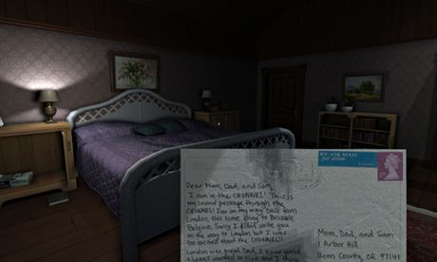
Engagement
Competence the second psychological need discussed within SDT looks at opportunities for individuals to acquire new skills or be challenged and receive positive feedback and this fulfils intrinsic motivation. Within video game play an example of competence would be where the game can be mastered and challenges within the game can be optimised and there are opportunities for positive feedback. (Rigby & Ryan 2007; Rigby & Ryan, 2011). Competence can be defined as feeling a sense of effectedness (Rigby & Ryan, 2011), with people intrinsically motivated to pursue opportunities to feel competent, because feeling effective gives us energy and motivates further. Mastering the mechanics of game play and accomplishing achievements via levels or tasks in game play enables this sense of competence which in turn adds to the feeling of well being.
Competence the second psychological need discussed within SDT looks at opportunities for individuals to acquire new skills or be challenged and receive positive feedback and this fulfils intrinsic motivation. Within video game play an example of competence would be where the game can be mastered and challenges within the game can be optimised and there are opportunities for positive feedback. (Rigby & Ryan 2007; Rigby & Ryan, 2011). Competence can be defined as feeling a sense of effectedness (Rigby & Ryan, 2011), with people intrinsically motivated to pursue opportunities to feel competent, because feeling effective gives us energy and motivates further. Mastering the mechanics of game play and accomplishing achievements via levels or tasks in game play enables this sense of competence which in turn adds to the feeling of well being.
Mastering the mechanics of game play and accomplishing achievements via levels or tasks in game play enables this sense of competence which in turn adds to the feeling of well being.
Mastering the mechanics of game play and accomplishing achievements via levels or tasks in game play enables this sense of competence which in turn adds to the feeling of well being.
Mastering the mechanics of game play and accomplishing achievements via levels or tasks in game play enables this sense of competence which in turn adds to the feeling of well being.
Mastering the mechanics of game play and accomplishing achievements via levels or tasks in game play enables this sense of competence which in turn adds to the feeling of well being.
Engagement & Immersion
Kirakowski & Curran (2011) have investigated the online immersion experience, which they suggest is much richer than offline. Immersion is sometimes known as presence in a game, (Ryan, Rigby, & Przybylski, 2006) and according to Kirakowski & Curran (2011) is quite a subjective experience and is a very real, albeit psychological phenomenon, that they observed in Role Playing Games's (RPG'S).
Qualitative data from 38 individual gamers was analysed by Kirakowski & Curran (2011) and results found two different types of immersion; one that immersion is a state of involvement in an imaginary setting and or character trait and secondly that there was an intense subjective experience as a result of the gamers actions on either the setting or character.
Character attachment and experiencing the storyline offer the player more immersive experiences, this has been tested in movies as well as games and gaming can offer a heightened experience.
Notes:
Applied perspective Gone home does both of these really well – taken the attachment to the characters and others for example the sister and also have a great story about the family

Slide 49
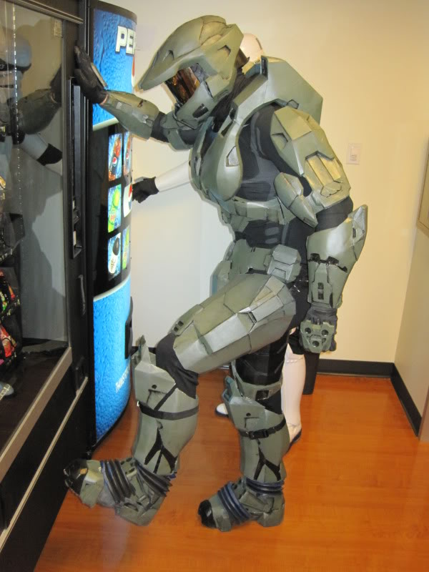
Engagement
Competence the second psychological need discussed within SDT looks at opportunities for individuals to acquire new skills or be challenged and receive positive feedback and this fulfils intrinsic motivation. Within video game play an example of competence would be where the game can be mastered and challenges within the game can be optimised and there are opportunities for positive feedback. (Rigby & Ryan 2007; Rigby & Ryan, 2011). Competence can be defined as feeling a sense of effectedness (Rigby & Ryan, 2011), with people intrinsically motivated to pursue opportunities to feel competent, because feeling effective gives us energy and motivates further. Mastering the mechanics of game play and accomplishing achievements via levels or tasks in game play enables this sense of competence which in turn adds to the feeling of well being.
Competence the second psychological need discussed within SDT looks at opportunities for individuals to acquire new skills or be challenged and receive positive feedback and this fulfils intrinsic motivation. Within video game play an example of competence would be where the game can be mastered and challenges within the game can be optimised and there are opportunities for positive feedback. (Rigby & Ryan 2007; Rigby & Ryan, 2011). Competence can be defined as feeling a sense of effectedness (Rigby & Ryan, 2011), with people intrinsically motivated to pursue opportunities to feel competent, because feeling effective gives us energy and motivates further. Mastering the mechanics of game play and accomplishing achievements via levels or tasks in game play enables this sense of competence which in turn adds to the feeling of well being.
Mastering the mechanics of game play and accomplishing achievements via levels or tasks in game play enables this sense of competence which in turn adds to the feeling of well being.
Mastering the mechanics of game play and accomplishing achievements via levels or tasks in game play enables this sense of competence which in turn adds to the feeling of well being.
Mastering the mechanics of game play and accomplishing achievements via levels or tasks in game play enables this sense of competence which in turn adds to the feeling of well being.
Mastering the mechanics of game play and accomplishing achievements via levels or tasks in game play enables this sense of competence which in turn adds to the feeling of well being.
Engagement & Immersion
Research by Przybylski, Weinstein, Murayama, Lynch & Ryan (2012) looked at the intrinsic motivation of game players seeking to realise their 'ideal self' and that playing a character in a video game allows an individual to 'try on' an ideal self.
This research involved both laboratory and online settings and the results were quite robust suggesting that the ideal self and video game self were expressed by higher intrinsic motivation and positive feelings.
When an individual has the opportunity to express themselves via game play and identify and attach to a player there is more options to monetise around emotions.
Notes:
Half Life, Mater Chief, The power and importance of story in a video game is increasing. The Writer's Guild of America now has an award category for outstanding achievement in videogame writing, as does BAFTA (The Walking Dead won 2013's award for best story). But few would deny that this art sits, not alongside film and literature, but somewhere else entirely. Nowhere else does the author and reader collaborate in the telling of a story.

Slide 50
Engagement
Competence the second psychological need discussed within SDT looks at opportunities for individuals to acquire new skills or be challenged and receive positive feedback and this fulfils intrinsic motivation. Within video game play an example of competence would be where the game can be mastered and challenges within the game can be optimised and there are opportunities for positive feedback. (Rigby & Ryan 2007; Rigby & Ryan, 2011). Competence can be defined as feeling a sense of effectedness (Rigby & Ryan, 2011), with people intrinsically motivated to pursue opportunities to feel competent, because feeling effective gives us energy and motivates further. Mastering the mechanics of game play and accomplishing achievements via levels or tasks in game play enables this sense of competence which in turn adds to the feeling of well being.
Competence the second psychological need discussed within SDT looks at opportunities for individuals to acquire new skills or be challenged and receive positive feedback and this fulfils intrinsic motivation. Within video game play an example of competence would be where the game can be mastered and challenges within the game can be optimised and there are opportunities for positive feedback. (Rigby & Ryan 2007; Rigby & Ryan, 2011). Competence can be defined as feeling a sense of effectedness (Rigby & Ryan, 2011), with people intrinsically motivated to pursue opportunities to feel competent, because feeling effective gives us energy and motivates further. Mastering the mechanics of game play and accomplishing achievements via levels or tasks in game play enables this sense of competence which in turn adds to the feeling of well being.
Mastering the mechanics of game play and accomplishing achievements via levels or tasks in game play enables this sense of competence which in turn adds to the feeling of well being.
Mastering the mechanics of game play and accomplishing achievements via levels or tasks in game play enables this sense of competence which in turn adds to the feeling of well being.
Mastering the mechanics of game play and accomplishing achievements via levels or tasks in game play enables this sense of competence which in turn adds to the feeling of well being.
Mastering the mechanics of game play and accomplishing achievements via levels or tasks in game play enables this sense of competence which in turn adds to the feeling of well being.
Engagement & Immersion
Schoenau – Fog (2012)
Desire for continuation to play – The player engagement process – An exploration of Continuation Desire in Digital Games ...... Used the 131 respondents, 310 statements.
High levels of emotional engagement keeps player wanting to play (Brown & Cairns, 2004)
Sensory Challenged Based imaginative immersion (SCI) Ermi & Mayra (2005) occurs when players become absorbed with the world and stories, or begin to empathise or identify with game characters. Sensory immersion is associated
with the audiovisual elements of games and challenge-based immersion is concerned with the balance of challenges and abilities.
Another elemental property of games which is also related to engagement is the
possibility of playing and Brown and Vaughan (2009) propose that a central element of
the concept of play is the desire to continue: “Play provides a continuation desire. We
desire to keep doing it, and the pleasure of the experience drives that desire. We find
ways to keep doing it. If something threatens to stop the fun, we improvise new rules or
conditions so that the play doesn’t have to end. And when it is over, we want to do it
again” (p. 18).
Notes:
Master of own destiny – real world perception of high autonomy but not really.....

Slide 51
Engagement
Competence the second psychological need discussed within SDT looks at opportunities for individuals to acquire new skills or be challenged and receive positive feedback and this fulfils intrinsic motivation. Within video game play an example of competence would be where the game can be mastered and challenges within the game can be optimised and there are opportunities for positive feedback. (Rigby & Ryan 2007; Rigby & Ryan, 2011). Competence can be defined as feeling a sense of effectedness (Rigby & Ryan, 2011), with people intrinsically motivated to pursue opportunities to feel competent, because feeling effective gives us energy and motivates further. Mastering the mechanics of game play and accomplishing achievements via levels or tasks in game play enables this sense of competence which in turn adds to the feeling of well being.
Competence the second psychological need discussed within SDT looks at opportunities for individuals to acquire new skills or be challenged and receive positive feedback and this fulfils intrinsic motivation. Within video game play an example of competence would be where the game can be mastered and challenges within the game can be optimised and there are opportunities for positive feedback. (Rigby & Ryan 2007; Rigby & Ryan, 2011). Competence can be defined as feeling a sense of effectedness (Rigby & Ryan, 2011), with people intrinsically motivated to pursue opportunities to feel competent, because feeling effective gives us energy and motivates further. Mastering the mechanics of game play and accomplishing achievements via levels or tasks in game play enables this sense of competence which in turn adds to the feeling of well being.
Mastering the mechanics of game play and accomplishing achievements via levels or tasks in game play enables this sense of competence which in turn adds to the feeling of well being.
Mastering the mechanics of game play and accomplishing achievements via levels or tasks in game play enables this sense of competence which in turn adds to the feeling of well being.
Mastering the mechanics of game play and accomplishing achievements via levels or tasks in game play enables this sense of competence which in turn adds to the feeling of well being.
Mastering the mechanics of game play and accomplishing achievements via levels or tasks in game play enables this sense of competence which in turn adds to the feeling of well being.
Engagement & Immersion
Schoenau – Fog (2012)
Activities – such as experimenting, creating, destroying, exploring, interfacing socialising, solving sensing experiencing the story & Characters
Accomplishments, to achieve, completion & progression
Affect – positive/negative absorption
Objectives – intrinsic/extrinsic
The framework attempts to explain how engaging player experiences are sustained and how the categories and components of player engagement support the desire to continue playing
Notes:
Master of own destiny – real world perception of high autonomy but not really.....

Slide 52
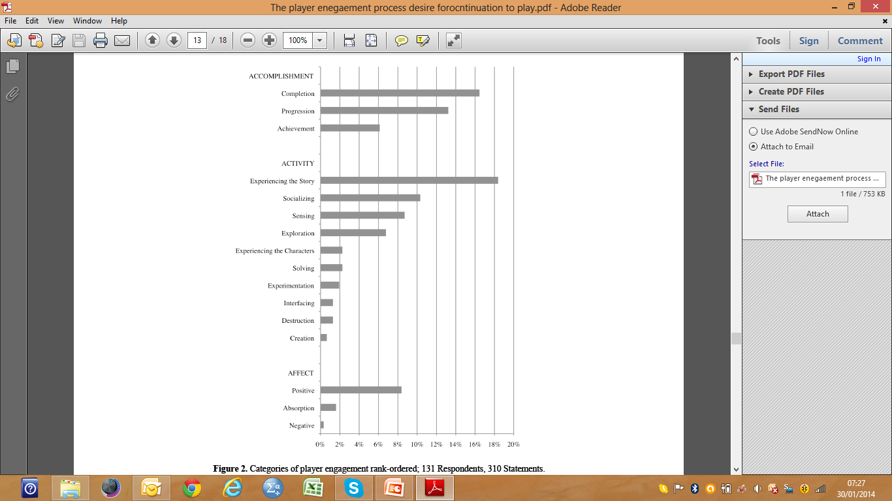
Engagement
Competence the second psychological need discussed within SDT looks at opportunities for individuals to acquire new skills or be challenged and receive positive feedback and this fulfils intrinsic motivation. Within video game play an example of competence would be where the game can be mastered and challenges within the game can be optimised and there are opportunities for positive feedback. (Rigby & Ryan 2007; Rigby & Ryan, 2011). Competence can be defined as feeling a sense of effectedness (Rigby & Ryan, 2011), with people intrinsically motivated to pursue opportunities to feel competent, because feeling effective gives us energy and motivates further. Mastering the mechanics of game play and accomplishing achievements via levels or tasks in game play enables this sense of competence which in turn adds to the feeling of well being.
Competence the second psychological need discussed within SDT looks at opportunities for individuals to acquire new skills or be challenged and receive positive feedback and this fulfils intrinsic motivation. Within video game play an example of competence would be where the game can be mastered and challenges within the game can be optimised and there are opportunities for positive feedback. (Rigby & Ryan 2007; Rigby & Ryan, 2011). Competence can be defined as feeling a sense of effectedness (Rigby & Ryan, 2011), with people intrinsically motivated to pursue opportunities to feel competent, because feeling effective gives us energy and motivates further. Mastering the mechanics of game play and accomplishing achievements via levels or tasks in game play enables this sense of competence which in turn adds to the feeling of well being.
Mastering the mechanics of game play and accomplishing achievements via levels or tasks in game play enables this sense of competence which in turn adds to the feeling of well being.
Mastering the mechanics of game play and accomplishing achievements via levels or tasks in game play enables this sense of competence which in turn adds to the feeling of well being.
Mastering the mechanics of game play and accomplishing achievements via levels or tasks in game play enables this sense of competence which in turn adds to the feeling of well being.
Mastering the mechanics of game play and accomplishing achievements via levels or tasks in game play enables this sense of competence which in turn adds to the feeling of well being.
Engagement & Immersion
Schoenau – Fog (2012)
Developed a framework for player engagement Although Character is lower it can be included in the story experience. Socialising was the second results for Activity – inc NPC.
Notes:
Master of own destiny – real world perception of high autonomy but not really.....

Slide 53



Psychological Research on Gamer Perception in the F2P model
Psychological Research on Gamer Perception in the F2P model
Exploring the value of purchasing online game items Park & Lee (2011)
Neglected area of research NOT the same as player behaviour.
This research seeks to scientifically explore the gamers perception of online game purchase of items from a consumer psychological perspective.
Utilises the Theory of consumption value never before used
theory of consumptive values for gaming with regard to item purchases
Notes:
TCV 20 years old has five values - functional, social, emotional, conditional and epistemic. Well researched psychological theory used to examine sports sponsorship, frequent flyer programs, tourism, organic food purchases etc. In technology its been used to understand motivation to download mp3, users experience in smart phones etc. If gamers perceive good ‘value’ more likely to pay for something....

Slide 54
Psychological Research on Gamer Perception in the F2P model
Psychological Research on Gamer Perception in the F2P model
Few studies have looked at the motivation of F2P gamers to purchase game items
Many have looked at addiction, game user behaviour, motivation for playing online games, factors affecting intentions to play online games, research fills a void.
Important for game developers to understand what will make repeated purchases
South Korea is rife with F2P games and gamers so its a good place to look at research in F2P
Specifically seeks to understand the value of purchasing game items & identify relevant factors affecting game users’ intention to purchase game items
Reviewed common features around literature about player behaviour around in-game purchase
Enjoyment, character competency, visual authority and monetary value
Notes:
Included some very high profile resources such as Live Gamer, probably the worlds largest.
Enjoyment fun, playfulness value, escapism, Character competency value, be stronger functional props and attributes, visual authority value, showing off, vanity, social value and monetary value investment, value for money requirement of the quest and hobby.

Slide 55
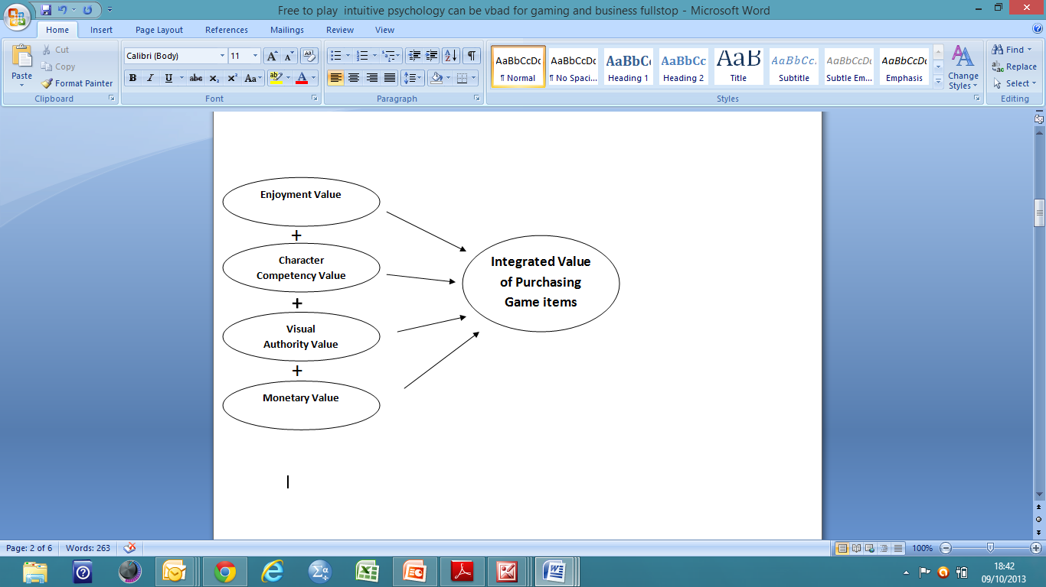
Psychological Research on Gamer Perception in the F2P model
Psychological Research on Gamer Perception in the F2P model
Exploring the value of purchasing online game items Park & Lee (2011)
New construct: The Integrated Value of Purchasing
Game Items:
Four value components:
Enjoyment value
Character Competency value
Visual Authority value
Monetary value
Also looked at Character Identification value and Satisfaction value
The integrated value of purchasing game items Park & Lee (2011)
Notes:
Character identification gamers identify with characters as they represent the user in a social context in the game. Real emotions around what happens to their avatars and the avatars actions. Temp alteration of the gamers self concept. Satisfied customers repeat purchase, studied extensively – so there was assumptions that satisfied gamers would repeat pourchase and therefore would have intention to purchase in-game items, repeadly.

Slide 56

Psychological Research on Gamer Perception in the F2P model
The Hypotheses (what are we trying to figure out?)
H1: The integrated consumption value of online game items (including the four values) is positively related with a user’s intention to purchase that item
H2: Character identification is positively related to the intention to purchase game items.
H3: Satisfaction about the game is positively related to the intention to purchase game items.
Notes:
Included soem very high profile resourses such as Live Gamer, proabaly teh worlds largest

Slide 57
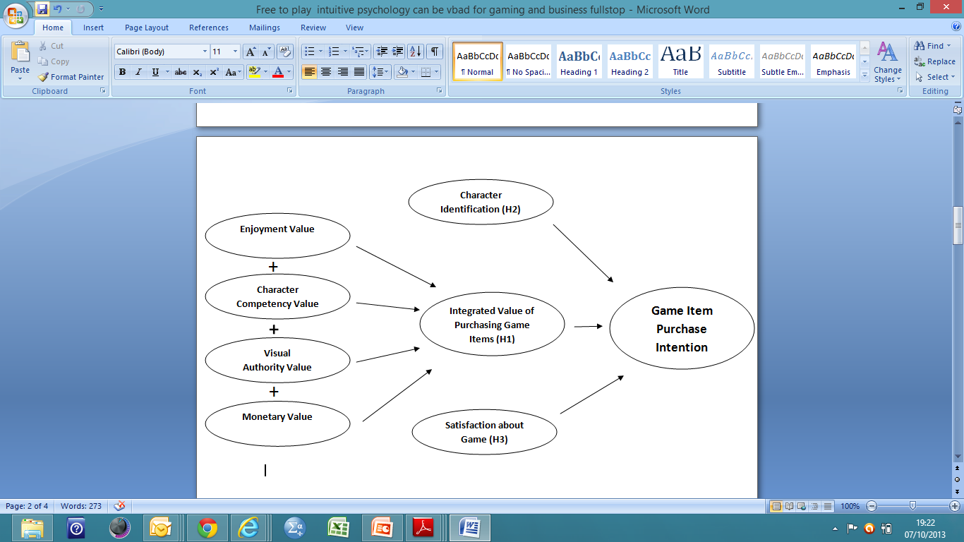
Psychological Research on Gamer Perception in the F2P model
The Hypotheses
Hypotheses Park & Lee (2011)
Notes:
Included soem very high profile resourses such as Live Gamer, proabaly teh worlds largest
Distal etc etc

Slide 58
Psychological Research on Gamer Perception in the F2P model
Methodology
327 participants, 250 male 77 female – age 13 upwards this was based on online game players who play F2P games so level of male was normal distribution for South Korea
Participants filled in questionnaire developed by the researchers after extensive literature reviews which had been checked for internal consistency and reliability. Had good Cronbach’s Alpha scores often used for reliability of psychometric tests.
There was a total of 24 questions, e.g:
I can make my characters look better
When I use the game I find the game more exciting
I increase my powers
When I play an online game I almost feel like the character
I intend to buy game items in the future
A robust and well measured valid methodology
Park & Lee (2011)
Notes:
Included soem very high profile resourses such as Live Gamer, proabaly teh worlds largest

Slide 59
Psychological Research on Gamer Perception in the F2P model
Results
There were strong significant findings for both the intergraded value of purchasing game items (across all four components) and character identification.
The integrated consumption value of online game items and character identification are positively related to the intention to purchase game items.
The findings did not support the association between satisfaction about the game and the intention to purchase game items.
Satisfaction is not enough to enable predictive purchase of game items
How to price game items accurately to match the perceived value is very important.
This research could be extended to include older gamers and to see more balance with female gamers, as well as other formats.
Park & Lee (2011)
Notes:
Included some very high profile resources such as Live Gamer, probably the worlds largest

Slide 60
Consumer Psychology
Competence the second psychological need discussed within SDT looks at opportunities for individuals to acquire new skills or be challenged and receive positive feedback and this fulfils intrinsic motivation. Within video game play an example of competence would be where the game can be mastered and challenges within the game can be optimised and there are opportunities for positive feedback. (Rigby & Ryan 2007; Rigby & Ryan, 2011). Competence can be defined as feeling a sense of effectedness (Rigby & Ryan, 2011), with people intrinsically motivated to pursue opportunities to feel competent, because feeling effective gives us energy and motivates further. Mastering the mechanics of game play and accomplishing achievements via levels or tasks in game play enables this sense of competence which in turn adds to the feeling of well being.
Competence the second psychological need discussed within SDT looks at opportunities for individuals to acquire new skills or be challenged and receive positive feedback and this fulfils intrinsic motivation. Within video game play an example of competence would be where the game can be mastered and challenges within the game can be optimised and there are opportunities for positive feedback. (Rigby & Ryan 2007; Rigby & Ryan, 2011). Competence can be defined as feeling a sense of effectedness (Rigby & Ryan, 2011), with people intrinsically motivated to pursue opportunities to feel competent, because feeling effective gives us energy and motivates further. Mastering the mechanics of game play and accomplishing achievements via levels or tasks in game play enables this sense of competence which in turn adds to the feeling of well being.
Mastering the mechanics of game play and accomplishing achievements via levels or tasks in game play enables this sense of competence which in turn adds to the feeling of well being.
Mastering the mechanics of game play and accomplishing achievements via levels or tasks in game play enables this sense of competence which in turn adds to the feeling of well being.
Mastering the mechanics of game play and accomplishing achievements via levels or tasks in game play enables this sense of competence which in turn adds to the feeling of well being.
Mastering the mechanics of game play and accomplishing achievements via levels or tasks in game play enables this sense of competence which in turn adds to the feeling of well being.
Repurchase and Recommendation
Kim (2012)
Understanding key factors in Users’ Intentions to Repurchase and Recommend Digital Items in Social Virtual Worlds
Collected data from 256 users of digital items
Focused on Social Virtual Worlds (SVW) such as Secondlife, Cyworld & Habbo Hotel
According to the Expectation Confirmation Model (Andersen, 1973) – users tend to be satisfied if perceived performance meet or exceed their expectation
Dissatisfied customers are more likely to spread negative word of mouth and convey a lower level of repurchasing intention than satisfied users – hundreds of studies looked at post adoption consumer intentions and positive word of mouth around perceived word-of-mouth
What post play messages and ‘cliff hangers’ and end of session play experiences are the players left with? Remind player of value & satisfaction.....
Notes:
Master of own destiny – real world perception of high autonomy but not really.....

Slide 61
Why do people prefer mobile games?
Good (2013)
Of the participants who said mobile was their preferred choice of gaming platform issues around time was the main reason for them preferring mobile games:
'It helps reduce boredom when waiting at work'; ‘
Passes time and stimulates me'; ‘
Fills a five minute gap when waiting for friends'; ‘
It passes time and I can pick it up and leave it
when I want to.‘
Other themes that came up from mobile game preference were:
Ease of use e,g., 'Easy to access' ;
Easy to do as with me most of the time';
Ease of use, I can do it anywhere'.
Convenience e.g. 'It's convenient I can play
on the way home.‘
Easy to handle, convenient.' Also I can do this when I am out and about or at home'.
Happiness/Enjoyment e.g. I get a lot of fun from it, makes me very happy.
Notes:
Included soem very high profile resourses such as Live Gamer, proabaly teh worlds largest
Distal etc etc

Slide 62
Why do people prefer mobile games?
: Relative to males, females will show a greater score in autonomy when playing mobile games versus console.
Results indicated that in relation to females, males have a greater preference for PC versus mobile in the autonomy subscale and therefore there was a significant effect (f1, 60) = 3.269, p < .05).
: Relative to males, females will show a greater score in autonomy when playing mobile games versus console.
Results indicated that in relation to females, males have a greater preference for PC versus mobile in the autonomy subscale and therefore there was a significant effect (f1, 60) = 3.269, p < .05).
These results are in sympathy with the idea of an improved self concept making one happy, as in the work by Durkin & Barber, (2002). It seems to support the U&G theory (Schramm, Lyle, & Parker, 1961) in that people seek out entertainment to make them happy.
These results are in sympathy with the idea of an improved self concept making one happy, as in the work by Durkin & Barber, (2002). It seems to support the U&G theory (Schramm, Lyle, & Parker, 1961) in that people seek out entertainment to make them happy.
These results are in sympathy with the idea of an improved self concept making one happy, as in the work by Durkin & Barber, (2002). It seems to support the U&G theory (Schramm, Lyle, & Parker, 1961) in that people seek out entertainment to make them happy.
These results are in sympathy with the idea of an improved self concept making one happy, as in the work by Durkin & Barber, (2002). It seems to support the U&G theory (Schramm, Lyle, & Parker, 1961) in that people seek out entertainment to make them happy.
Good (2013)
The findings of research supported the hypotheses that the both males and females were happier playing mobile games versus console and pc games as measured by the Authentic Happiness Scale (Authentic Happiness Scale, 2006).
The fact that females get so much pleasure from playing mobile games challenges the stereo typical and is in sympathy with the work of Williams, Yee, Caplan, (2008); Williams, Consalvo, Caplan, & Yee, (2009).
These results are in sympathy with the idea of an improved self concept via competence making one happy, as in the work by Durkin & Barber, (2002). It seems to support the U&G theory (Schramm, Lyle, & Parker, 1961) in that people seek out entertainment to make them happy.
There was significant findings for Competence and Autonomy measures using the PENS scale but none for Relatedness in mobile game play
Males saw mobile game playing as more intrusive in their lives and females did not! Rather counterintuitive?
Notes:
Included soem very high profile resourses such as Live Gamer, proabaly teh worlds largest
Distal etc etc

Slide 63


VR
Competence the second psychological need discussed within SDT looks at opportunities for individuals to acquire new skills or be challenged and receive positive feedback and this fulfils intrinsic motivation. Within video game play an example of competence would be where the game can be mastered and challenges within the game can be optimised and there are opportunities for positive feedback. (Rigby & Ryan 2007; Rigby & Ryan, 2011). Competence can be defined as feeling a sense of effectedness (Rigby & Ryan, 2011), with people intrinsically motivated to pursue opportunities to feel competent, because feeling effective gives us energy and motivates further. Mastering the mechanics of game play and accomplishing achievements via levels or tasks in game play enables this sense of competence which in turn adds to the feeling of well being.
Competence the second psychological need discussed within SDT looks at opportunities for individuals to acquire new skills or be challenged and receive positive feedback and this fulfils intrinsic motivation. Within video game play an example of competence would be where the game can be mastered and challenges within the game can be optimised and there are opportunities for positive feedback. (Rigby & Ryan 2007; Rigby & Ryan, 2011). Competence can be defined as feeling a sense of effectedness (Rigby & Ryan, 2011), with people intrinsically motivated to pursue opportunities to feel competent, because feeling effective gives us energy and motivates further. Mastering the mechanics of game play and accomplishing achievements via levels or tasks in game play enables this sense of competence which in turn adds to the feeling of well being.
Mastering the mechanics of game play and accomplishing achievements via levels or tasks in game play enables this sense of competence which in turn adds to the feeling of well being.
Mastering the mechanics of game play and accomplishing achievements via levels or tasks in game play enables this sense of competence which in turn adds to the feeling of well being.
Mastering the mechanics of game play and accomplishing achievements via levels or tasks in game play enables this sense of competence which in turn adds to the feeling of well being.
Mastering the mechanics of game play and accomplishing achievements via levels or tasks in game play enables this sense of competence which in turn adds to the feeling of well being.
Great research Virtual Super heroes. Using superpowers in virtual reality to encourage prosocial behaviour. Rosenberg, Baughman & Bailenson (2014)
Two conditions, one ‘superhero’ one passenger in helicopter.
Those participants who were superheros helped to pick up pens that the
experimenter spilt a pot of post flying activity.
All sorts of possibilities for influencing real world interactions to make more prosocial. You will help more if primed to be a superhero who is perceived to be all helping etc.,
What does this mean for transfer of online behaviours in game offline around violence?
Notes:
We know that people suspend their sense of self in virtual worlds this will be heightened on VR worlds - Disinhibition effect.

Slide 64
When my character is facing
The characters I play reflect who I am
My character and I are one and the same
The characters I play influence the way I f
Mobile VR – When???
F2P Conference 2013
Mobile VR headsets already developed - Smartphone-based virtual reality headset from Samsung and Oculus VR could make the technology more accessible
demonstrates a new set of challenges:
Mobile devices, theoretically, offer a more liberating experience
Heat is our primary issue,” says Cohen. “When you run a mobile phone’s CPUs and GPUs at maximum, the device heats up really quickly, and it needs to either cut the speed by throttling or shut down entirely.” Gear VR
There’s also the fact that phone displays don’t refresh as frequently as other screens, which can make them appear to flicker and thus ruin the illusion
Then there’s the problem of positional tracking, needed to accurately transpose the user’s head movements into the virtual space. The sensors in a smartphone do not provide very accurate motion tracking.
Battery life still a problem – the context for the player will be difficult – Big psychological leap!
Notes:
Some people have difficulty distinguishing a psychophysiologist from a physiological psychologist, two very different perspectives. Psychologists are interested in why we may fearspiders and physiologists may be interested in the input/output system of the amygdala. Barcelna based neuroelectrics Neuroelectrics has developed a wireless, easy-to-use technology that can monitor your brain activity (through EEG) and stimulate it while you are playing games in order to treat different pathologies, such as chronic pain, depression and for stroke rehabilitation.") They claim they "apply excitatory currents into the particular area of the brain and helps them to reduce their pain levels". I'm not aware of any validated treatment that electrically stimulates the brain in a non-invasive fashion - the only studies I could turn up for wireless neuron activation were in tissue samples (this one). Can now use facial recognition
Can we write on to brains? Manipulate

Slide 65
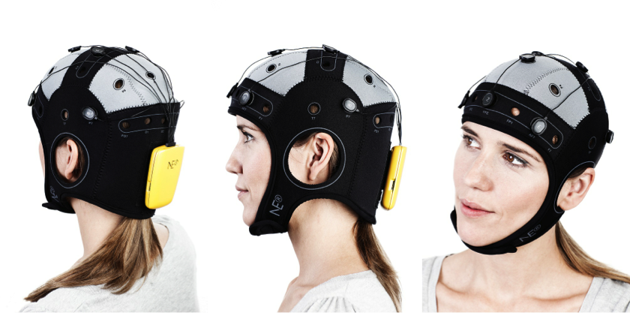
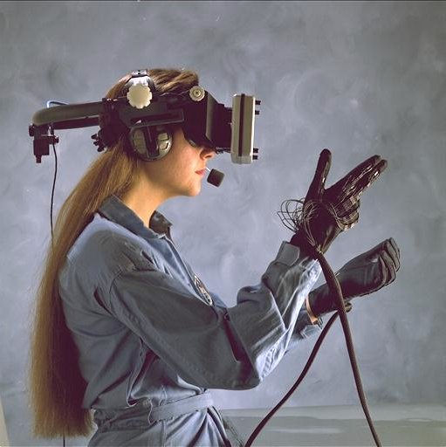
When my character is facing
The characters I play reflect who I am
My character and I are one and the same
The characters I play influence the way I f
Psychological Research around VR and gaming
F2P Conference 2013
Right now VR is primarily a visual thing, but I think its going to need to expand all of our other senses including touch, sound and balance...... Creating peripherals that strap on to the end of our sensory systems, heads, our noises and our ears...If we can get perfect VR we are not going to need to perfect much else. Palmer Luckey
Presence is still the key – we know this from immersion in video games, it will be presence that will determine if VR enable real life experiences
Notes:
Barcelona based neuroelectronics

Slide 66
When my character is facing
The characters I play reflect who I am
My character and I are one and the same
The characters I play influence the way I f
NeuroGaming
F2P Conference 2013
NeuroGaming “Where mind and body meet to play games” (Zach Lynch, founder NeuroGaming Conference)
Measuring physiological responses, such as EEG, eye tracking, and PH levels from sweat.
Games can be a powerful source for therapy
Learning on VR can mean a deeper encoding of information easier to recall and retain because of the immersive nature
Using the data from players what ethical and financial implications?
Still some way to delivery experiences that are as close as reality in game play
Using psychology can help developers design games that have more of an immersive experience, satisfy more intrinsic needs, and combine the psychological research with physiological (psycho physiological) responses will ultimately make better games.
Notes:
Some people have difficulty distinguishing a psychophysiologist from a physiological psychologist, two very different perspectives. Psychologists are interested in why we may fearspiders and physiologists may be interested in the input/output system of the amygdala. Barcelna based neuroelectrics Neuroelectrics has developed a wireless, easy-to-use technology that can monitor your brain activity (through EEG) and stimulate it while you are playing games in order to treat different pathologies, such as chronic pain, depression and for stroke rehabilitation.") They claim they "apply excitatory currents into the particular area of the brain and helps them to reduce their pain levels". I'm not aware of any validated treatment that electrically stimulates the brain in a non-invasive fashion - the only studies I could turn up for wireless neuron activation were in tissue samples (this one). Can now use facial recognition
Can we write on to brains? Manipulate

Slide 67
Get in touch!
Berni Good
e: berni@cyberpsychologist.co.uk
w: www.cyberpsychologist.co.uk
t: 07580 069 045
Thank you for listening

